Slide 1
Monte Carlo Simulation for Stoplight
Team members - Akhila Khanapuri
Roshini Seshadri
Natalie DeClerck

Slide 2
What are we doing?
We plan to simulate the flow of traffic at a stoplight at a four way intersection.
The purpose is to find the optimized time for stoplight so that the average waiting time of a vehicle is reduced.

Slide 3
Hypothesis used for the simulation:
A four way road intersection is used.
The simulations for arrival times of car on North-South road is uniformly distributed around a higher lower mean.
We assume that one of the road is busier than the other road. The simulations for arrival times of car on East-West road is uniformly distributed around a higher mean
We are randomizing the direction in which a car can travel, i.e., Left, Right or Straight.

Slide 4
What inspired us to choose this scenario?
Traffic has always been one of the everyday issues especially in busier area/towns/cities. If the same traffic stoplight duration is used for all the areas irrespective of the time of the day or the locality of the stoplight, we can mostly expect higher chances of traffic.
Since every stoplight cannot be fixed with a sensor for detecting the traffic and appropriately changing the signal, we aim to find the best time for a stoplight which will prevent the heavy traffic jam and reduce the waiting time at an intersection.

Slide 5
What have we found most difficult or surprising in the work so far?
The inclusion of free right/left at certain signals is certainly one of the challenging things to accommodate for in this simulation.
We also faced difficulty in deciding the time granularity of the simulation.
Situations we still need to account for:
Left turns, especially to avoid a deadlock when two cars want to turn left at the same time
Right-on-red scenarios where conditions only apply to the first car in the queue

Slide 6
Work done so far
Cars arrive at random time intervals in 4 separate queues (North, South, East, West)
4-way stoplight is synced to switch between green and red for an amount of time set by the user
Summary stats collected on the average amount of wait-time for all cars in the simulation

Slide 7
Any possible different design for the simulation to work properly?
Object oriented approach?
How to avoid many global variables?
Best way to check conditions for right-on-red and left turns?

Slide 8
Ways in which we can expand our simulation
Including green arrows in our stoplight, or designated turn lanes, and how much those improve average wait time for the intersection.
Doing a cost-benefit analysis on adding sensors to change the stoplight depending on whether there are cars waiting.
We can extend out simulation to a network of stoplights at different intersection.
This simulation can also include other uncertain variables like, the hours of traffic (peak hours vs. non peak hours), if sensors are available at the stoplight and the neighborhood of the stoplight (busy area vs non busy area)

Slide 9
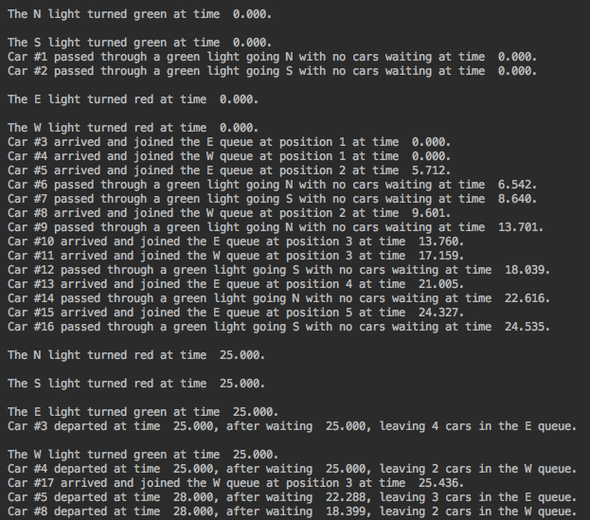

Slide 10
